Slide 1
Advanced Placement Exams
In the 2021-2022 School Year
Notes:
Al’s slides: 1 --> 4
Keleigh’s slides: 5+

Slide 2
Benefits of AP Courses
Get a Taste of College
Get familiar with college-level work -- boosting confidence by tackling challenging coursework
Develop College Skills
Time management, critical thinking, scholarly writing -- AP courses help students hone the skills they’ll need in college and career.
Discover Your Passion
Studying a subject in depth can give students new insights and even put them on the path to a career
Notes:
AL

Slide 3
Benefits of AP Courses
Signals to College Admissions
85% of colleges and universities report that a student’s AP experience favorably impacts admission decisions [1]
Academic Success
Research shows that students who receive a score of 3 or higher on AP Exams typically experience greater academic success in college and have higher graduation rates than their non-AP peers.[3]
Completion of Degree
Research shows that students who take AP courses and exams are much more likely than their peers to complete a college degree on time[4]—which means they avoid paying for, for example, a fifth year of tuition.
Notes:
AL

Slide 4
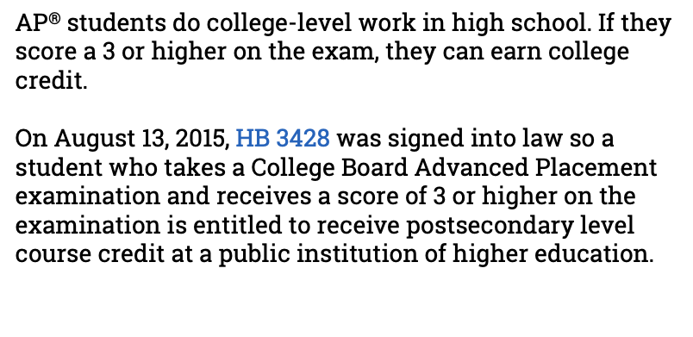

Slide 5
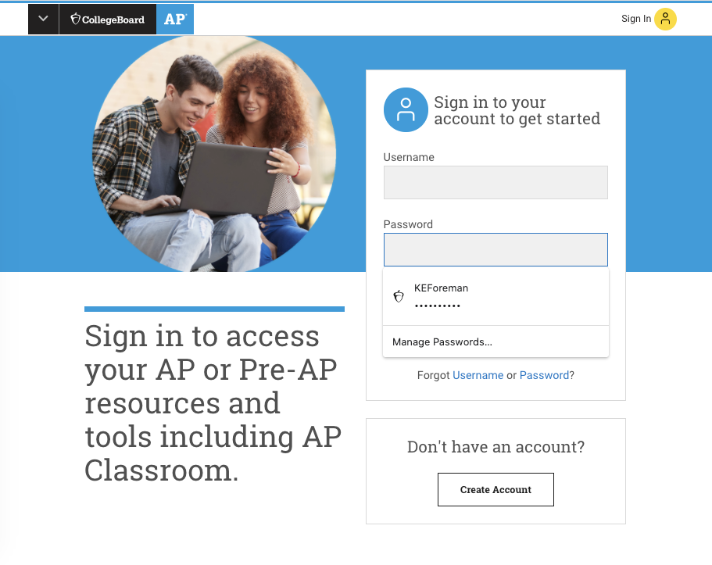
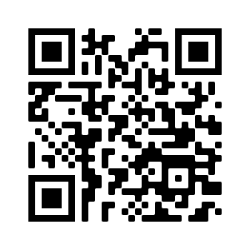
The AP Classroom
All students who enrolled in their teacher’s AP Classroom, are automatically registered for the AP Exam for that course.
https://myap.collegeboard.org/login
The AP Classroom is not the same as Canvas
All “second semester only courses” will have a separate registration period beginning January
AP Macroeconomics
Student/parent number: (888) 225-5427

Slide 6
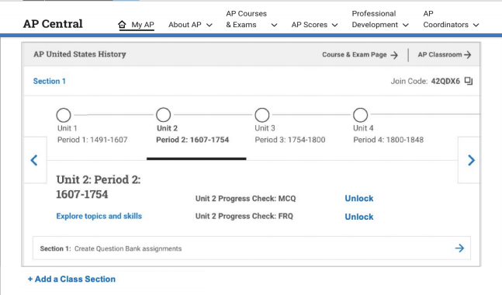
Resources in AP Classroom
❏ Unit Guides provides a comprehensive overview of course content.
❏ Personal Progress Checks provide students
with actionable feedback throughout the year.
❏ AP Question Bank boosts exam practice with
15,000+ on-demand AP Exam questions.
❏ Progress Dashboard highlights progress and areas of focus throughout the year.
Notes:
All of these components were in the AP Classroom last year for students who may have taken an AP Course

Slide 7
Instructional Videos
AP Daily videos are short on-demand segments led by expert AP teachers.
Can be viewed by students through AP Classroom
Can be assigned as “tasks” for students to see when logging into AP Classroom
Notes:
“AP Daily videos are short on-demand segments led by expert AP teachers. The videos can help you cover all course content and skills and use class time for focused discussions and collaboration.”

Slide 8
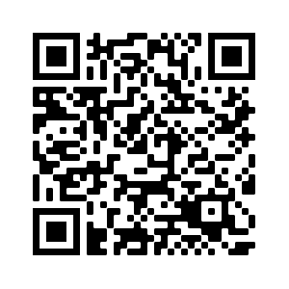
AP Testing for 2021 - 2022
❏ Tests for the Spring of 2022 will be full-length, in person tests administered at school
❏ AP Exams will be held two weeks in May:
May 2nd - 6th
May 9th - 13th
❏ For more details visit the College Board
website. Visit this link or QR code to get there
https://apcentral.collegeboard.org

Slide 9
Exam Fees
❏ First exam is covered by the District.
❏ Remaining exams will be covered by Elgin High School through Title I funds.*
*only applies to courses for which your child is currently enrolled in
❏ Students may elect to take additional exams that are offered at Elgin High School outside of their coursework, but will be responsible for the cost of the exam.
❏ Cost of exam = $96.00
❏ Contact Keleigh Foreman at keleighforeman@u-46.org or extension 5133 to register for any additional exams.

Slide 10
Additional Exam Fees
Additional College Board fees after November 15th:
Any Exam registration after November 15th will incur a late fee of $40.00.
Any AP Exam a student would like to cancel will incur a $40.00 “cancelation” fee.
Any Exam that is ordered in November, but not taken in May will incur a $40.00 “unused exam” fee.

Slide 11
Timeline for AP Exams
Date | Action | Cost
August → October 15th | Open enrollment for AP Classroom sections. Enrolling in an AP Classroom section automatically registers a student for that AP Exam. | $0.00 = There is no cost for enrolling in a course that corresponds to a class on the student’s schedule. $96.00 = cost of registering for an additional AP Exam, contact keleighforeman@u-46.org
October 16th → November 1st | Students will confirm which exams they are/aren’t taking with their classroom teachers. At this time students can “opt-out” of an AP exam they do not want to take. | $0.00 = no cost of opting out of an AP Exam during this window
November 15th → March 15th | Students may add additional AP Exams | $40.00 = late registration fee charged to student’s school account
 | Students may elect to opt-out of an exam | $40.00 = exam cancelation fee charged to student’s school account
May 2nd - 13th | AP Exams are conducted in school | $40.00 = “unused exam” charged for any exam that a student registers for but does not take on exam day.

Slide 13
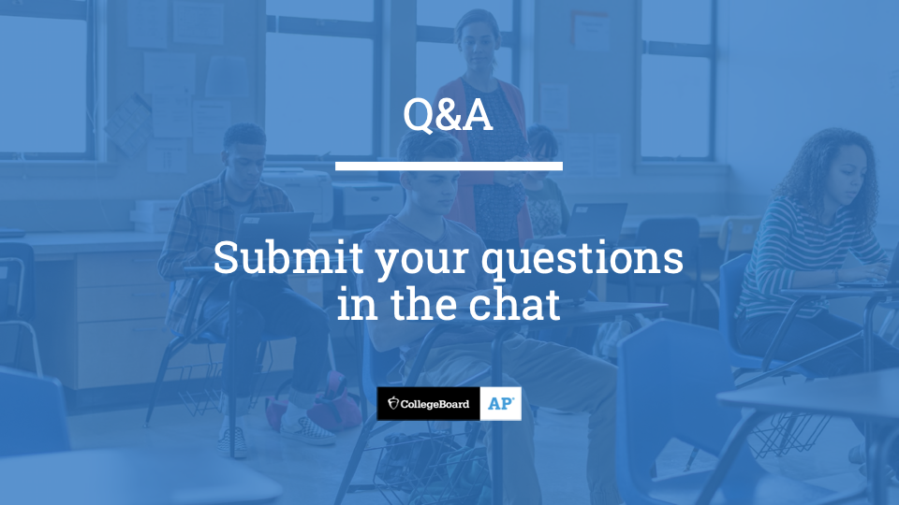

Slide 14
Contact:
Alan Flota
(847) 888-5100 x5104
AlanFlota@u-46.org
Keleigh Foreman
(847) 888-5100 x5133
KeleighForeman@u-46.org

